Slide 1
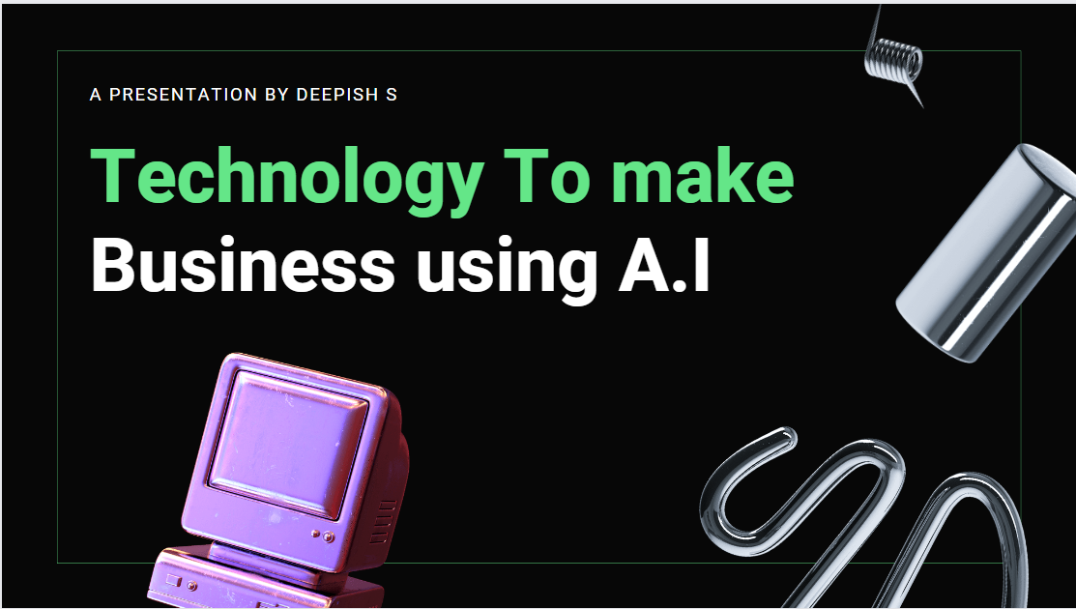

Notes:
https://duotone.shapefactory.co/?i=-HH3cGeAC4o&f=3fc7ff&t=2c0058&q=_
https://duotone.shapefactory.co/?f=3fc7ff&t=2c0058&q=_

Slide 2
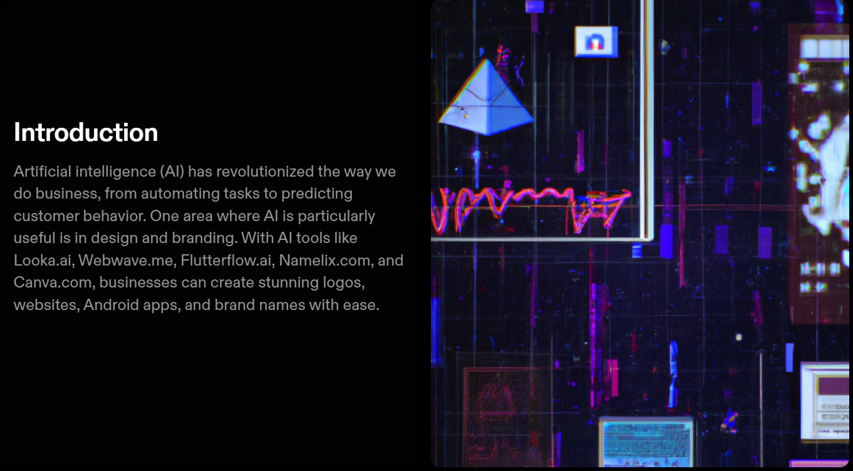
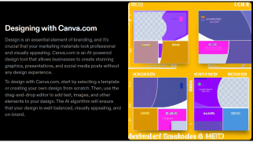
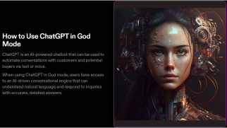
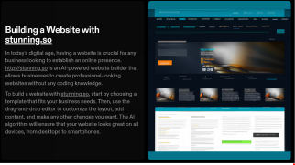
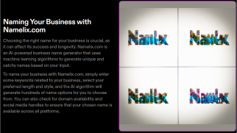
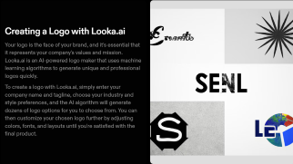
Notes:
https://duotone.shapefactory.co/?i=-HH3cGeAC4o&f=3fc7ff&t=2c0058&q=_
https://duotone.shapefactory.co/?f=3fc7ff&t=2c0058&q=_

Slide 3
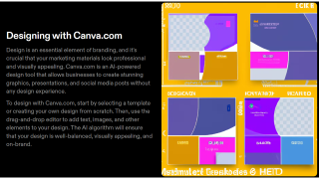


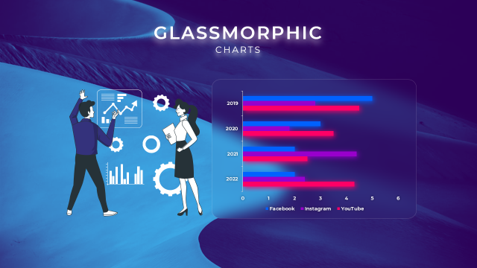


Notes:
https://duotone.shapefactory.co/?i=-HH3cGeAC4o&f=3fc7ff&t=2c0058&q=_
https://duotone.shapefactory.co/?f=3fc7ff&t=2c0058&q=_

Slide 4


Notes:
https://duotone.shapefactory.co/?i=-HH3cGeAC4o&f=3fc7ff&t=2c0058&q=_
https://duotone.shapefactory.co/?f=3fc7ff&t=2c0058&q=_

Slide 5

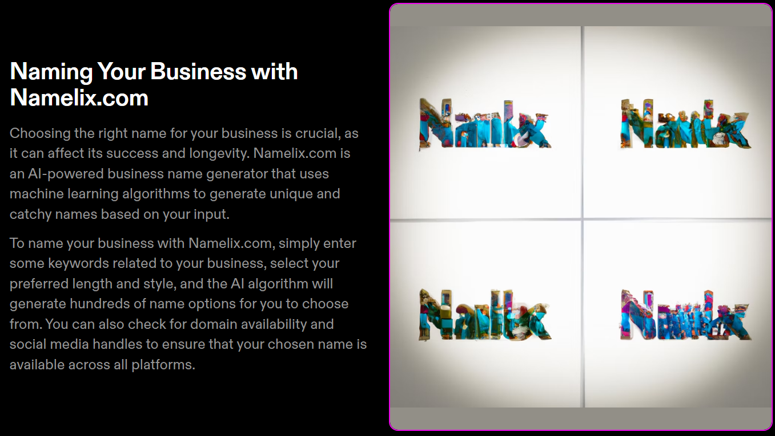
Notes:
https://duotone.shapefactory.co/?i=phIFdC6lA4E&f=3fc7ff&t=2c0058&q=_

Slide 6
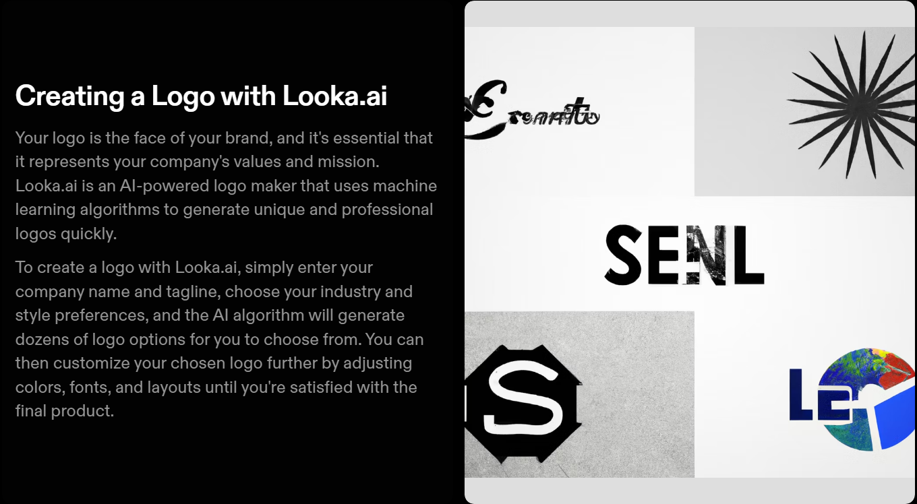
Notes:
https://storyset.com/illustration/meditation/bro
https://duotone.shapefactory.co/?i=-HH3cGeAC4o&f=3fc7ff&t=2c0058&q=_

Slide 7

Notes:
https://duotone.shapefactory.co/?i=roZgc7SXXmI&f=3fc7ff&t=2c0058&q=_

Slide 8
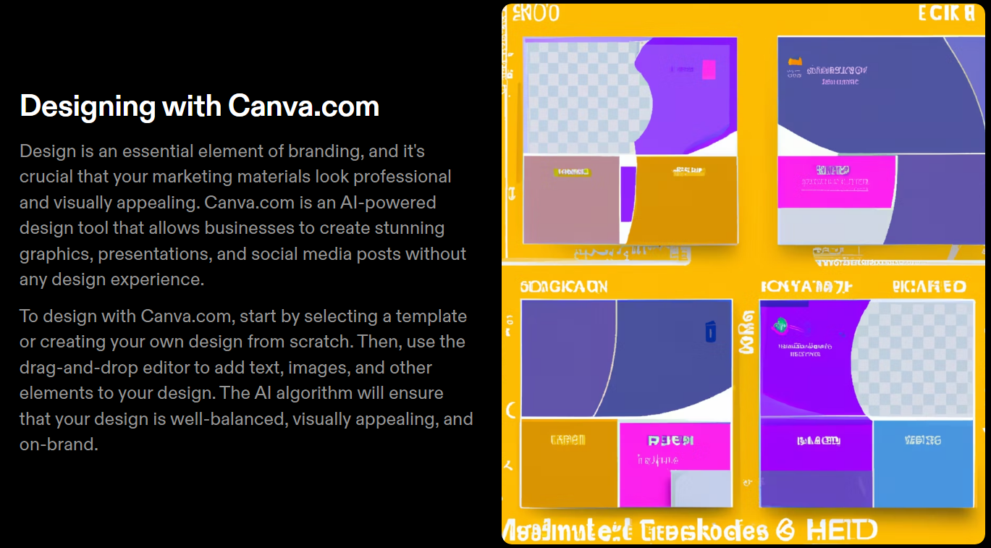

Slide 9

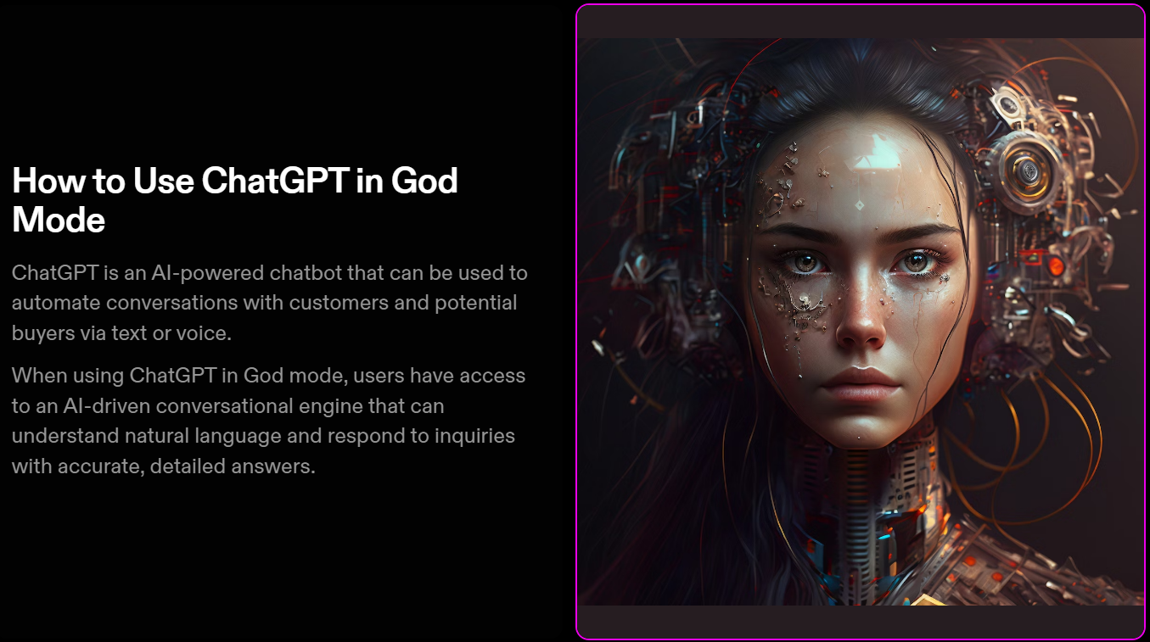
Notes:
https://storyset.com/illustration/business-plan/bro
https://duotone.shapefactory.co/?i=c65n6pgkXkI&f=3fc7ff&t=2c0058&q=_

Slide 10
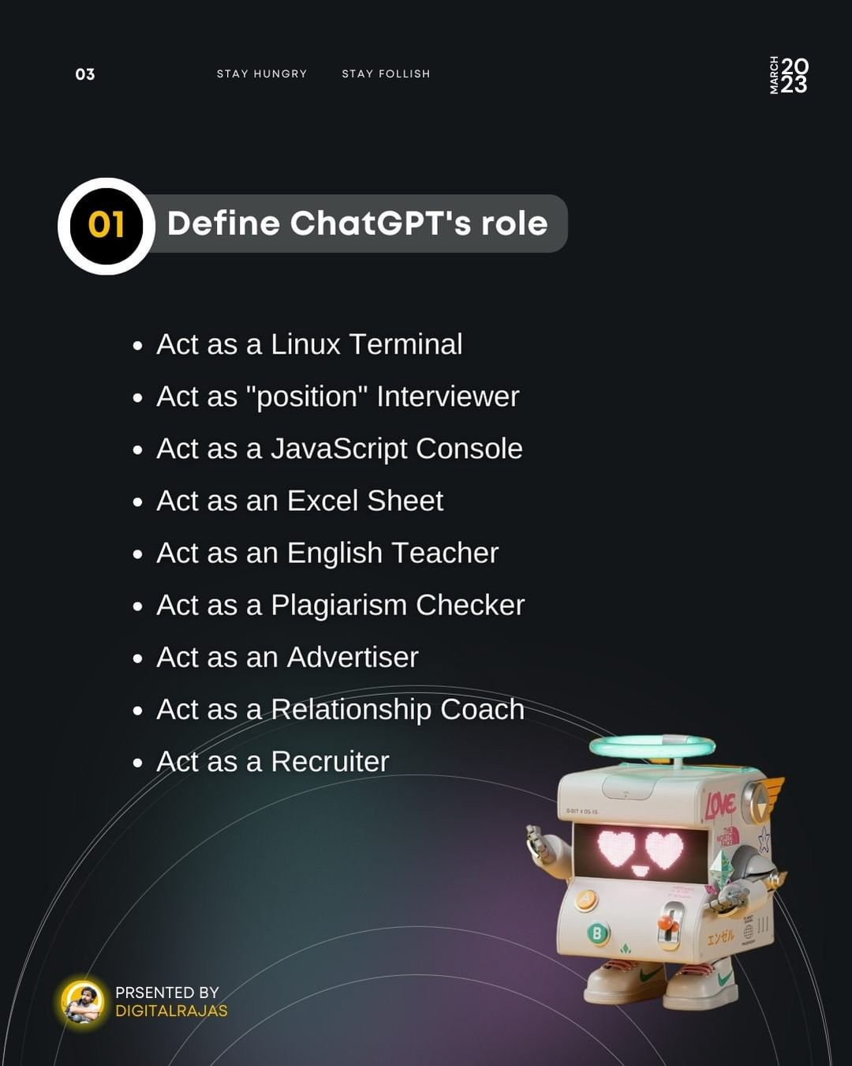
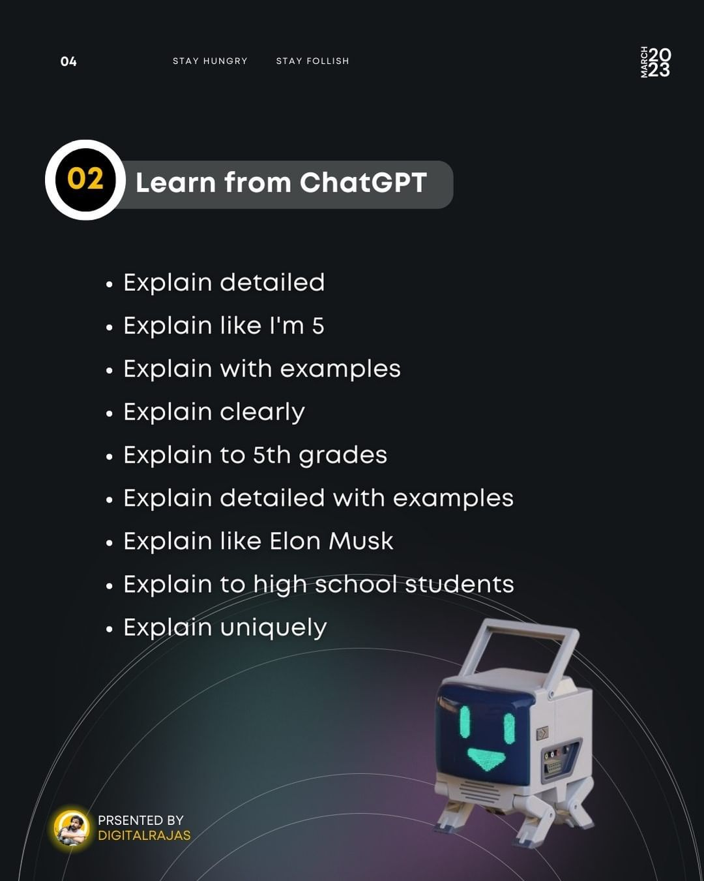

Slide 11
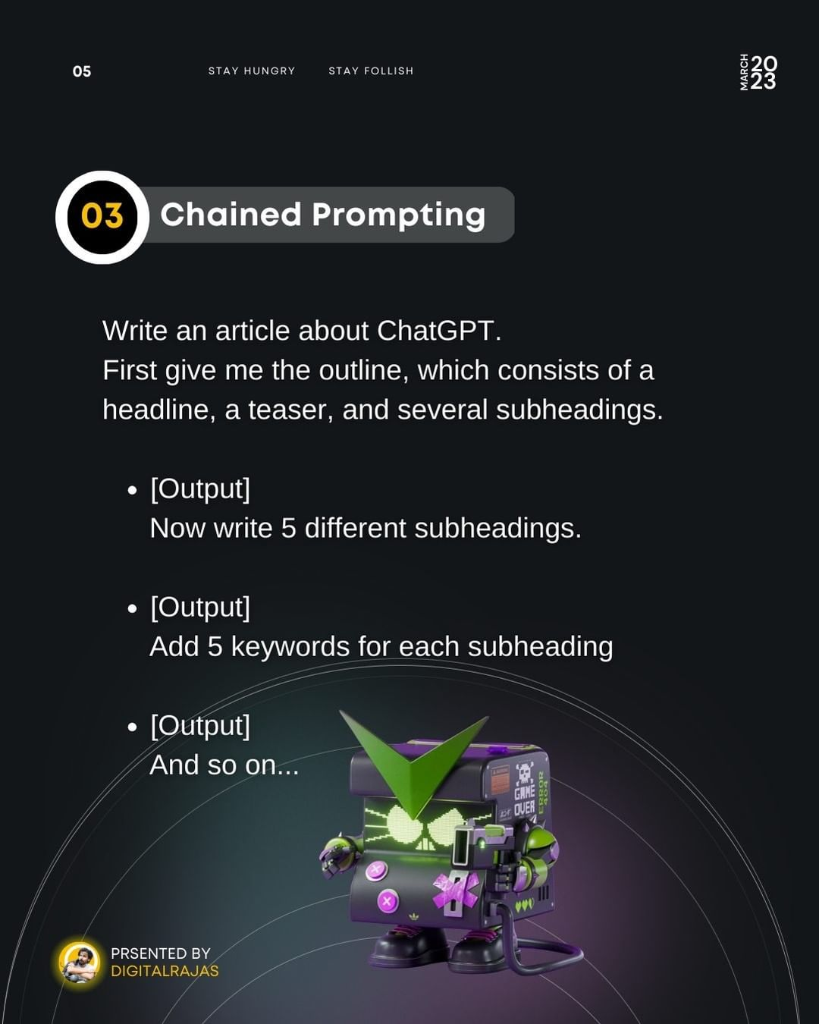
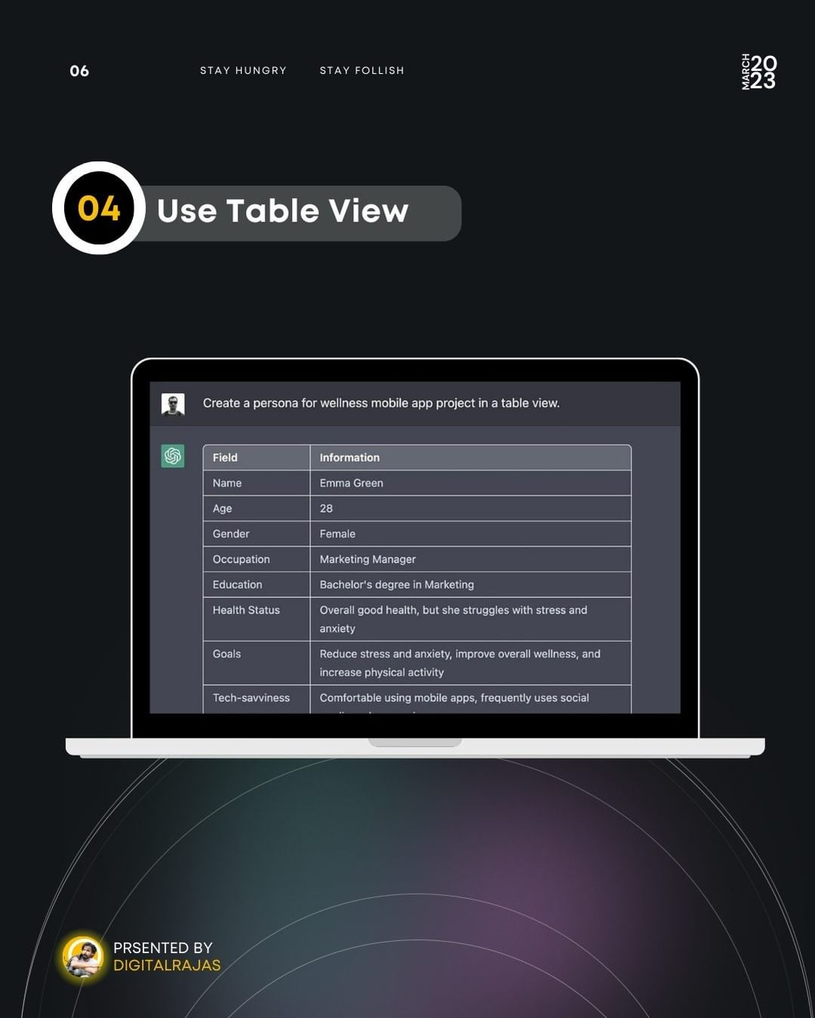

Slide 12
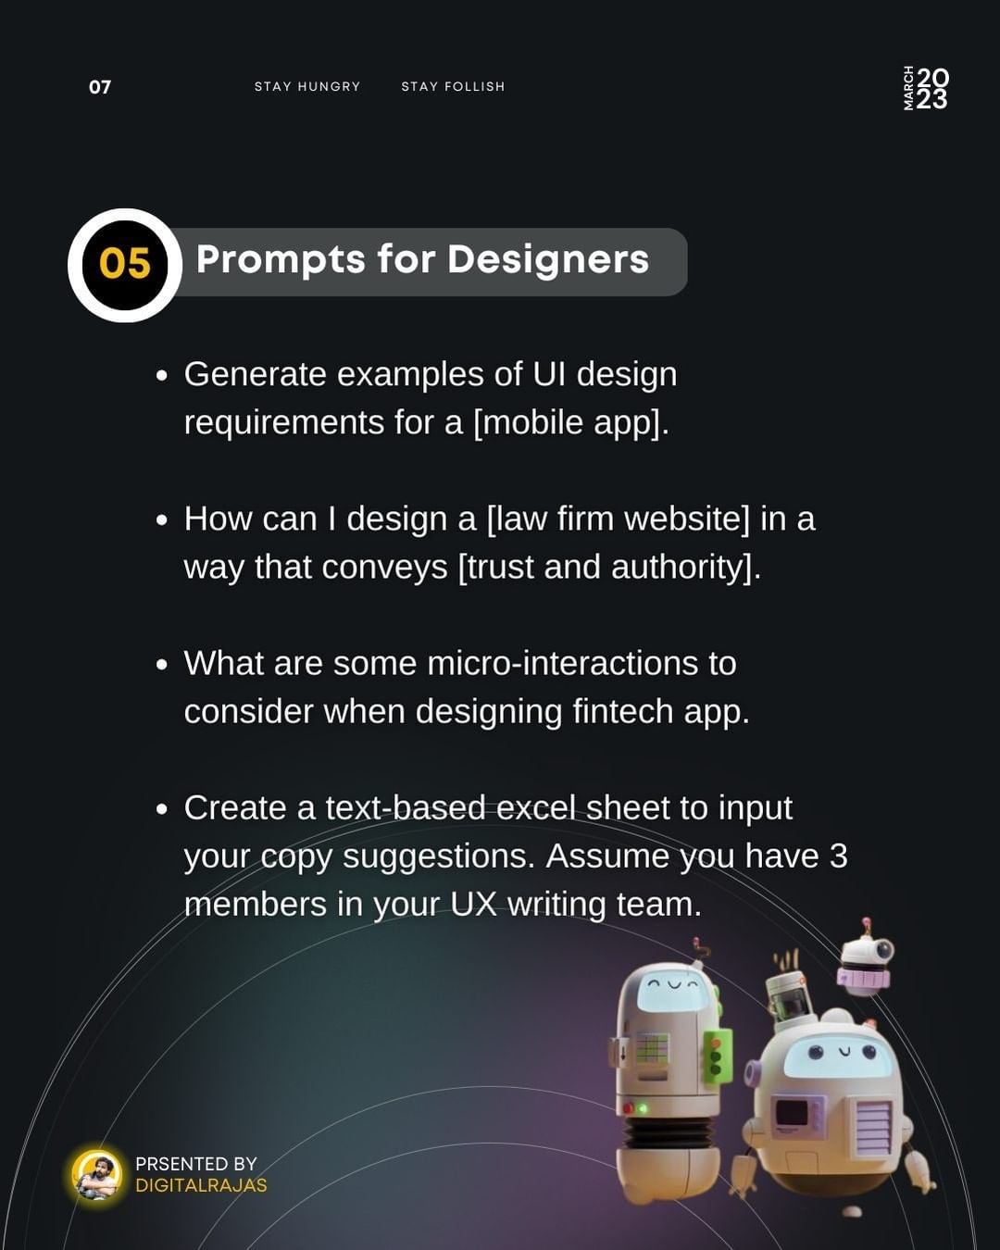
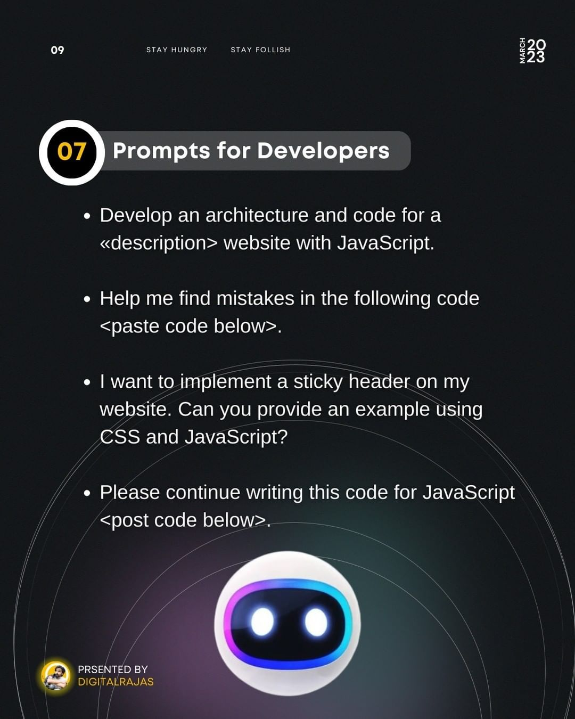

Slide 13
